Slide 1




Week-12 (Discussion)
14th October, 2024
Introduction to Machine Learning
Prof. Balaraman Ravindran
Professor and Head of the Department
Department of Data Science and Artificial Intelligence
IIT Madras
Ayan Paul
PMRF Research Scholar
IIT Kharagpur

Slide 2
Science of Machine Learning Research
Machine Learning Theory
Mix of mathematical science and experimental science
Experimental: cross-validation, held-out testing, deployment
Mathematical: theorems and proofs
Strongest contributions combine both styles of science
Machine Learning Theory, also known as Computational Learning Theory, aims to understand the fundamental principles of learning as a computational process and combines tools from Computer Science and Statistics.
Questions We Can Ask from learning theory
Under what assumptions can we guarantee some behavior of some learning algorithm?
What is the computational complexity of some algorithm?
What is the sample complexity required to fit some model?
How many mistakes will an online learner make?
How well will a learned model generalize when trained on a finite sample?

Slide 3
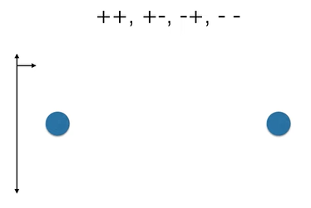
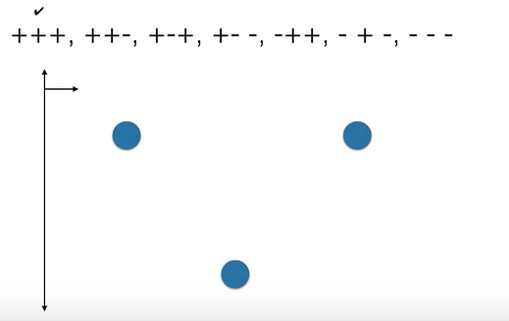

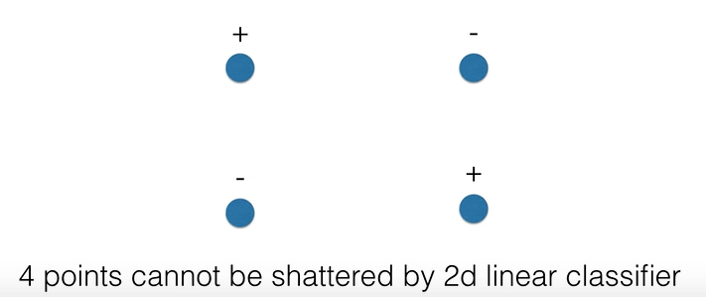
Foundational Concepts for theoretical limits of learning algorithms
1. VC Dimension
The VC (Vapnik-Chervonenkis Dimension) dimension is a measure of the capacity or complexity of a hypothesis class (a set of functions or classifiers). It essentially tells us how powerful a learning model is in terms of its ability to classify data correctly.
The VC dimension of a hypothesis H is the size of the largest set of points that can be shattered by H.
A set of points, S is shattered by a hypothesis if, for every possible labeling of those points, there exists a hypothesis in H that correctly classifies the points with that labeling.
Example:
Linear classifiers in 2D: Consider linear classifiers (lines) that separate points in a 2D plane. The VC dimension of linear classifiers in 2D is 3. This is because any 3 points in general position (not collinear) can be shattered by lines, but 4 points cannot always be shattered (there are configurations of 4 points that cannot be linearly separated).

Slide 4
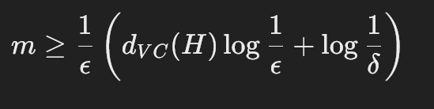

2. PAC Learning
PAC learning defines what it means for a learning algorithm to be successful. A hypothesis class is PAC-learnable if, given enough training data, the algorithm can produce a hypothesis that is probably (with high probability) approximately correct (within a small error margin).
A hypothesis class H is PAC-learnable if there exists a learning algorithm that, for any distribution of the data, can, with high probability, output a hypothesis h∈H such that the error of h is within a small margin ϵ, given a sufficient number of training samples m. This probability is at least 1−δ where δ is a small confidence parameter.
Time Complexity
In theoretical computer science, the time complexity is the computational complexity that describes the amount of computer time it takes to run an algorithm.
Where,
k is the number of iterations,
n is the number of data points,
d is the number of features.

Slide 5
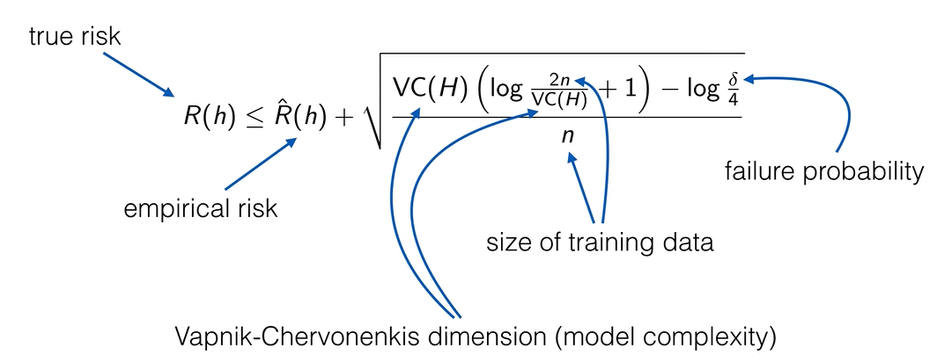
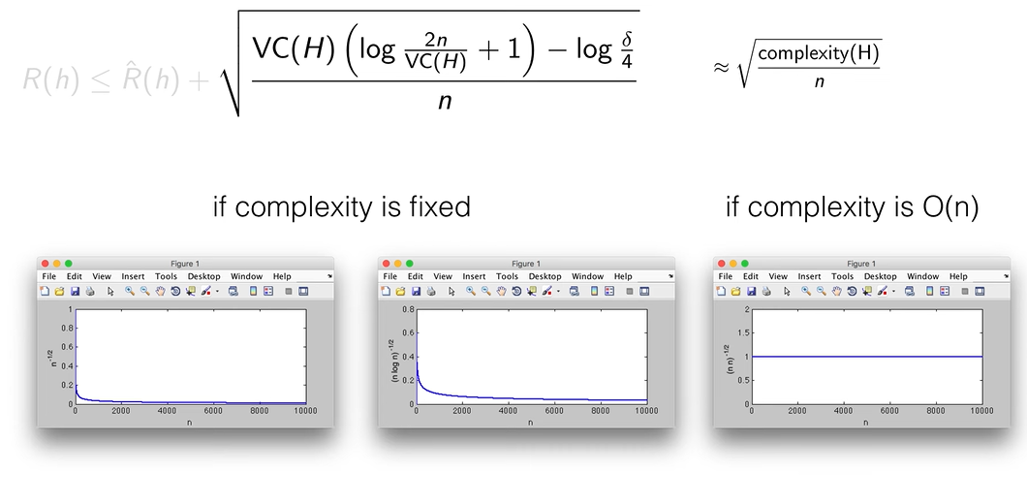
Generalization Error

Slide 6
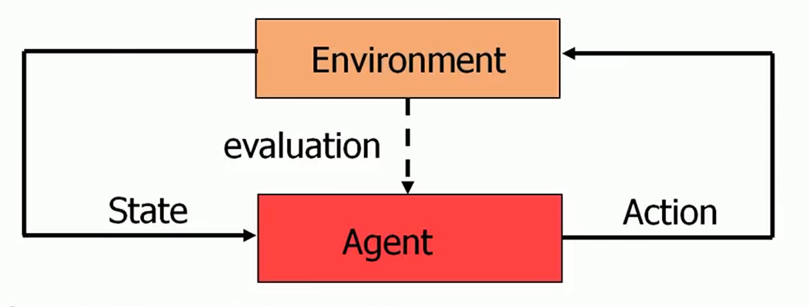
Reinforcement Learning
Reinforcement learning is learning about stimuli and actions based on rewards and punishment alone.
Unlike supervised learning, which relies on a training dataset with predefined answers, RL involves learning through experience.
In RL, an agent learns to achieve a goal in an uncertain, potentially complex environment by performing actions and receiving feedback through rewards or penalties.
Key Concepts
How Reinforcement Learning Works
Agent: The learner or decision-maker.
Environment: Everything the agent interacts with.
State: A specific situation in which the agent finds itself.
Action: All possible moves the agent can make.
Reward: Feedback from the environment based on the action taken.
RL operates on the principle of learning optimal behavior through trial and error. The agent takes actions within the environment, receives rewards or penalties, and adjusts its behavior to maximize the cumulative reward.
Policy: A strategy used by the agent to determine the next action based on the current state.
Reward Function: A function that provides a scalar feedback signal based on the state and action.
Value Function: A function that estimates the expected cumulative reward from a given state.
Model of the Environment: A representation of the environment that helps in planning by predicting future states and rewards.
RL Framework

Slide 7
Topics on which Week 12 Assignment Questions are based
Learning Theory
Reinforcement Learning

Slide 8
QUESTION 1
Statement 1: Empirical error is always greater than generalisation error.
Statement 2: Training data and test data have different underlying(true) distributions.
Choose the correct option:
(a) Statement 1 is true. Statement 2 is true. Statement 2 is the correct reason for statement 1.
(b) Statement 1 is true. Statement 2 is true. Statement 2 is not the correct reason for statement 1.
(c) Statement 1 is true. Statement 2 is false.
(d) Both statements are false.
SOLUTION 1
Empirical error can be greater than or less than generalisation error. In fact, it is typically less than generalisation error since the model tends to perform better on the data it has seen during training.
CORRECT ANSWER 1
d)

Slide 9
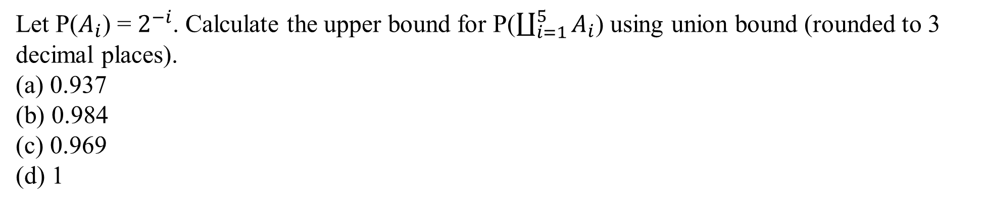
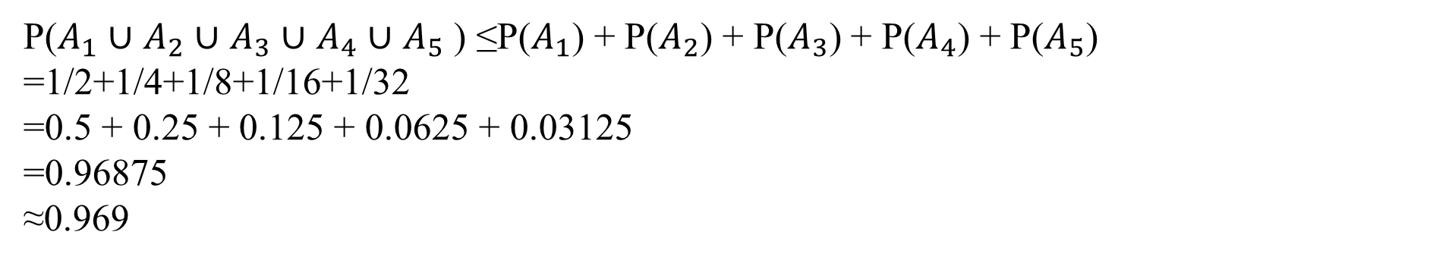
QUESTION 2
SOLUTION 2
CORRECT ANSWER 2
c)

Slide 10
QUESTION 3
Statement A: Reinforcement learning is a type of unsupervised learning.
Statement B: Reinforcement learning does not have labels.
Both statements are true. Statement B is the correct explanation for statement A.
Both statements are true. Statement B is NOT the correct explanation for statement A.
Statement A is true. Statement B is false.
Statement A is false. Statement B is true.
Both statements are false.
SOLUTION 3
Supervised
Input, Labels (Expected Output)
RL
Input: Current Positions, Expected Action
CORRECT ANSWER 3
d)

Slide 11
QUESTION 4
If a hypothesis class has a VC dimension of 4, what does it imply?
It can shatter any set of 4 points but not any set of 5 points.
It can perfectly classify any dataset.
It will always have zero training error.
It requires at least 4 training samples to achieve low generalization error.
SOLUTION 4
A VC dimension of 4 means the hypothesis class can shatter any set of 4 points, but there is no guarantee it can shatter any set of 5 points.
CORRECT ANSWER 4
a)

Slide 12
QUESTION 5
What is the VC dimension of the set of all linear classifiers in 2D?:
(a) 1
(b) 2
(c) 3
(d) 4
SOLUTION 5
The VC dimension of the set of all linear classifiers in 2D is 3 because three points in general position can always be separated by a line, but four points cannot always be shattered by a linear classifier in 2D.
CORRECT ANSWER 5
c)

Slide 13
QUESTION 6
What is a policy in reinforcement learning?
A mapping from states to actions
A mapping from states to rewards
A mapping from actions to rewards
A mapping from actions to next state
SOLUTION 6
A mapping from states to actions
CORRECT ANSWER 6
a)

Slide 14
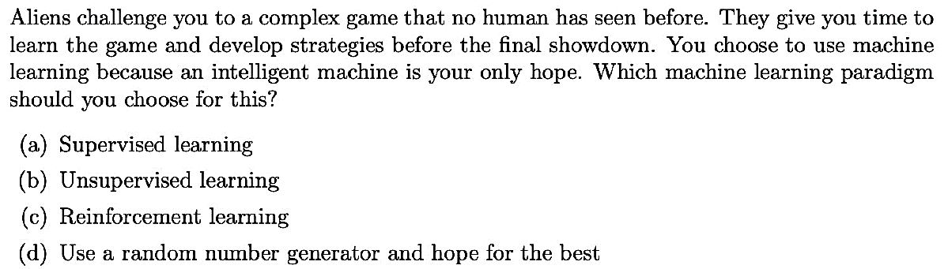
QUESTION 7
SOLUTION 7
CORRECT ANSWER 7
c)

Slide 15
QUESTION 8
You want to create a self-driving car software. In the context of the standard Reinforcement Learning framework, what would you classify as the state and actions? Note that your system does not have access to previous states.
a. State-(Current steering wheel position, Current pedal positions, Current speed) Actions-(Turn the steering wheel, Press pedals)
b. State-(Current steering wheel position, Current pedal positions, Current acceleration) Actions-(Turn the steering wheel, Press pedals)
c. State-(Current steering wheel position, Current pedal positions, Current speed) Actions-(Change direction, Change speed)
d. State-(Current steering wheel position, Current pedal positions, Current acceleration) Actions-(Change direction, Change speed)
SOLUTION 8
State-(Current steering wheel position, Current pedal positions, Current speed) Actions-(Turn the steering wheel, Press pedals)
CORRECT ANSWER 8
a)

Slide 16
QUESTION 9
Which type of feedback does an agent in reinforcement learning receive?
Predictions
Labels
Clusters
Rewards or penalties
SOLUTION 9
An agent in reinforcement learning receive feedback in the form of Rewards or penalties
CORRECT ANSWER 9
d)

Slide 17
QUESTION 10
Which of the following measure best analyze the performance of a classifier?
(a) Precision
(b) Recall
(c) Accuracy
(d) Time complexity
(e) Depends on the application
SOLUTION 10
Different applications might need to optimize different performance measures. Applications of machine learning span over playing games to very critical domains(such as health and security). So there cannot be a single measure to analyze the effectiveness of a classifier in all environments.
CORRECT ANSWER 10
e)

